Slide 1

Airbnb Analysis Dashboard
End-to-end Power BI solution delivering actionable insights on listings performance, revenue drivers, and market dynamics
Solo BI analyst: data prep, modeling, DAX, report design
-- Rupnath Shaw

Slide 2

The Challenge
Fragmented Data, Unclear Revenue Drivers
Regional teams lacked a unified view of performance across cities and listing types
Critical Questions
Where is revenue concentrated?
Which listing characteristics drive bookings?
How to optimize pricing while maintaining occupancy and guest satisfaction?
Goal: Build a self-service dashboard enabling data-driven decisions on pricing strategy and host acquisition

Slide 3

Data Architecture
Listings Table
Hosts Table
Listing-level attributes: city, room type, price, beds, bedrooms, bathrooms, response rate, guest favorite status
Host profiles: host ID, name, tenure (host_since), superhost flag, primary city
Sales Table
Dimension Tables
Transactional data: listing ID, booking date, nights booked, revenue per stay
City and date dimensions for consistent filtering and time intelligence
Granularity: Listing-day level rolling up to city × room type × price category
Time Period: 12 months of completed stays matching business reporting cycles

Slide 4
Data Cleaning & Transformation
01
02
03
Schema Standardization
Feature Engineering
Quality Control
Enforced proper data types for price, dates, numeric fields; stripped currency symbols and separators
Created Price_Category buckets (Low/Mid/High), host_tenure_bucket (0-1y, 1-3y, 3-5y, 5y+), guest_favourite flags
Imputed missing beds/bedrooms/bathrooms; standardized room_type labels; resolved duplicates
04
05
Data Integration
Outlier Removal
Joined tables on listing_id and host_id; removed orphaned sales records
Filtered test listings, extreme prices (<$10), negative revenues to ensure KPI accuracy

Slide 5

Dashboard Design Philosophy
Three-Page Structure
Top KPIs
Consistent Slicers
Brand Colors
Prominently display key metrics
City, Room Type, Price Category
Use Airbnb palette for cohesion
Overview
Room Analysis
Sales Deep-Dive
Executive snapshot: growth, city performance, supply mix
Supply & operations: listing characteristics, inventory distribution
Revenue managers: host performance, sales drivers
Drill Paths
Symmetry
City → Room Type → Host
Reduce cognitive load with balance

Slide 6
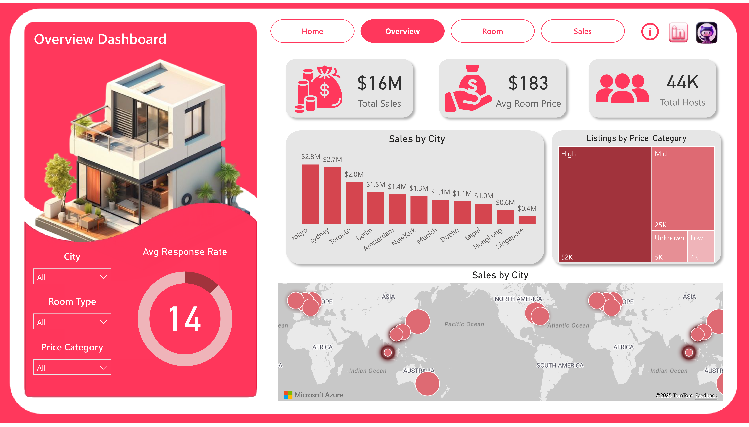

Slide 7
Overview Dashboard: Executive Snapshot
$16M
$183
44K
Total Sales
Avg Room Price
Total Hosts
12-month revenue
Across all markets
Active platform partners
Sales by City
Listings by Price Category
Revenue concentration across global markets
High: 52K listings | Mid: 25K | Low: 4K
Tokyo: $2.8M (top performer)
Treemap shows supply mix, revealing potential over-indexing on premium tiers
Sydney: $2.7M
Toronto, Berlin, Amsterdam: mid-tier markets
New York: significant contributor
Bar chart + map visualization reveals geographic concentration for marketing prioritization

Slide 8
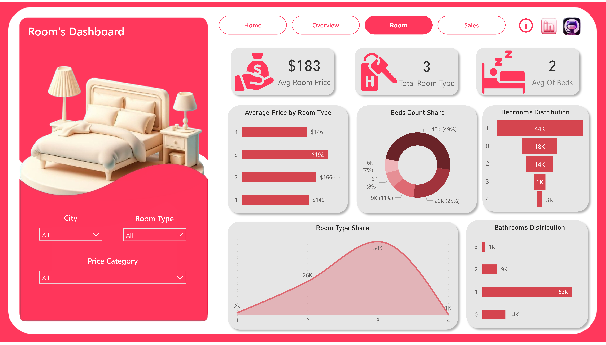

Slide 9
Room Dashboard: Supply Intelligence
Average Room Price
Average Beds
Room Type Categories
2-Bed Configuration Share
Room Type Pricing
Bedroom Distribution
Bathroom Analysis
Bar chart compares average prices across:
Most listings: 1-2 bedrooms
Distribution: 0-3 bathrooms
Entire home/apt
Sharp tail-off at larger sizes
Cross-filter with price reveals amenity correlation
Private room
Guides family-accommodation strategy
Shared room
Operations can segment Tokyo + High Price to compare premium vs. mid-tier structure
Boutique hotel
Identifies pricing opportunities by type

Slide 10
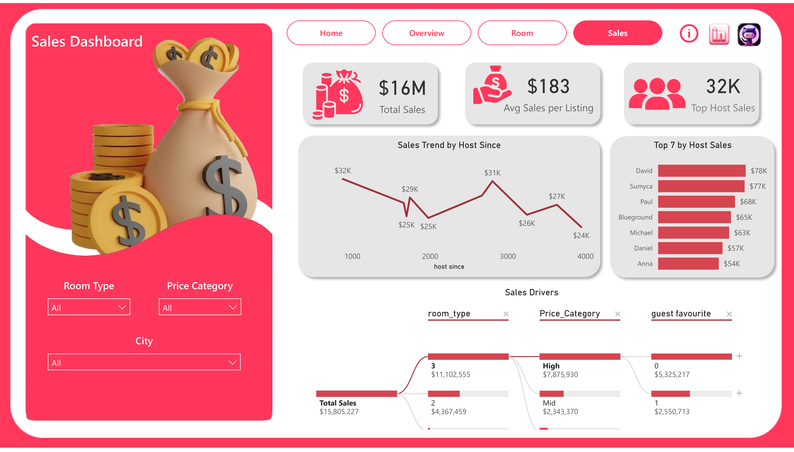

Slide 11
Sales Dashboard: Revenue Deep-Dive
$16M
$183
$32K
Total Sales
Avg Sales/Listing
Top Host Sales
Sales Trend by Host Tenure
Line chart reveals revenue increases with experience (1K-4K days active), then stabilizes
Sales Drivers Decomposition Tree
Total Sales → Room Type → Price Category → Guest Favourite status
Insight: First 1-2 years critical for host development; diminishing returns after 5 years
Key Finding: Room Type 3 + High price = majority of revenue; non-guest-favourite listings still drive substantial sales
Top Hosts by Revenue
David: $78K
Sumyca: $78K
Paul, Blueground, Michael: $77K
Identifies key partners for account management

Slide 12
Key Insights & Strategic Implications
Revenue Concentration
Supply Mix Imbalance
Core Segment: 2-Bed, 1-2 Bedroom
Finding: Tokyo and Sydney contribute ~35% of total sales ($5.5M combined)
Finding: High-priced listings (52K) vastly outnumber Low (4K) and Mid (25K)
Finding: 49% of inventory in 2-bed configuration; 1-2 bedrooms dominate
Action: Prioritize marketing and host support in top cities; set realistic targets for long-tail markets
Action: Expand mid-tier inventory to capture price-sensitive segments; re-segment pricing bands by market
Action: Optimize pricing, photos, amenities for this segment—highest ROI potential
Host Tenure Sweet Spot
Guest Experience Upside
Finding: Revenue peaks at 2-5 years tenure, then flattens
Finding: High-priced, non-guest-favourite listings still drive large revenue share
Action: Intensive onboarding and education in first 1-2 years; diminishing returns after 5 years
Action: Improve reviews, response times for high-value listings; marginal rating gains justify price increases

Slide 13
Business Impact & Value
This dashboard revolutionized Airbnb's reporting, transforming a manual, city-by-city Excel process into an interactive, data-driven system that empowers key stakeholders.
Streamlined Reporting
Quantified Strategic Drivers
Replaced manual Excel processes with a single, interactive dashboard for executives and teams.
Quantified impact of price categories, room types, and host tenure for data-driven decisions.
Empowered Self-Service
Projected Revenue Uplift
Stakeholders can now self-serve answers to critical questions in seconds, eliminating delays from ad-hoc analysis.
Estimated 5-10% revenue uplift in priority markets through optimized pricing and mix strategies.

Slide 14

Conclusion
Key Accomplishments & Impact
Future Enhancements
This project showcases my comprehensive BI skill set, transforming ambiguous business challenges into clear, data-driven solutions.
Booking-level Occupancy
Demand Forecasting
Predictive Pricing
Trend Analysis
Integrate detailed booking data
Use occupancy to forecast demand
Build dynamic pricing models
Detect patterns and seasonality
End-to-End BI Solution: Designed data model, cleaned and engineered features, developed DAX measures, and built an intuitive Power BI report.
Row-level Security
Automated Refresh
Scalable Foundation
Restrict data by region and role
Schedule regular data updates
Extendable for future capabilities
Actionable Insights: Moved beyond visuals to challenge assumptions about cities, pricing tiers, and host performance, driving strategic action.

Slide 15
Thank You

